Slide 1
VOJEXT Project & Open Calls
F6S Network Limited
Luisa Gonçalves
February 2021
EU Industry Week – Bulgarian SMEs
Notes:
Artificial Intelligence & Robotics for Sustainable Development Goals (AIR4S)

Slide 2
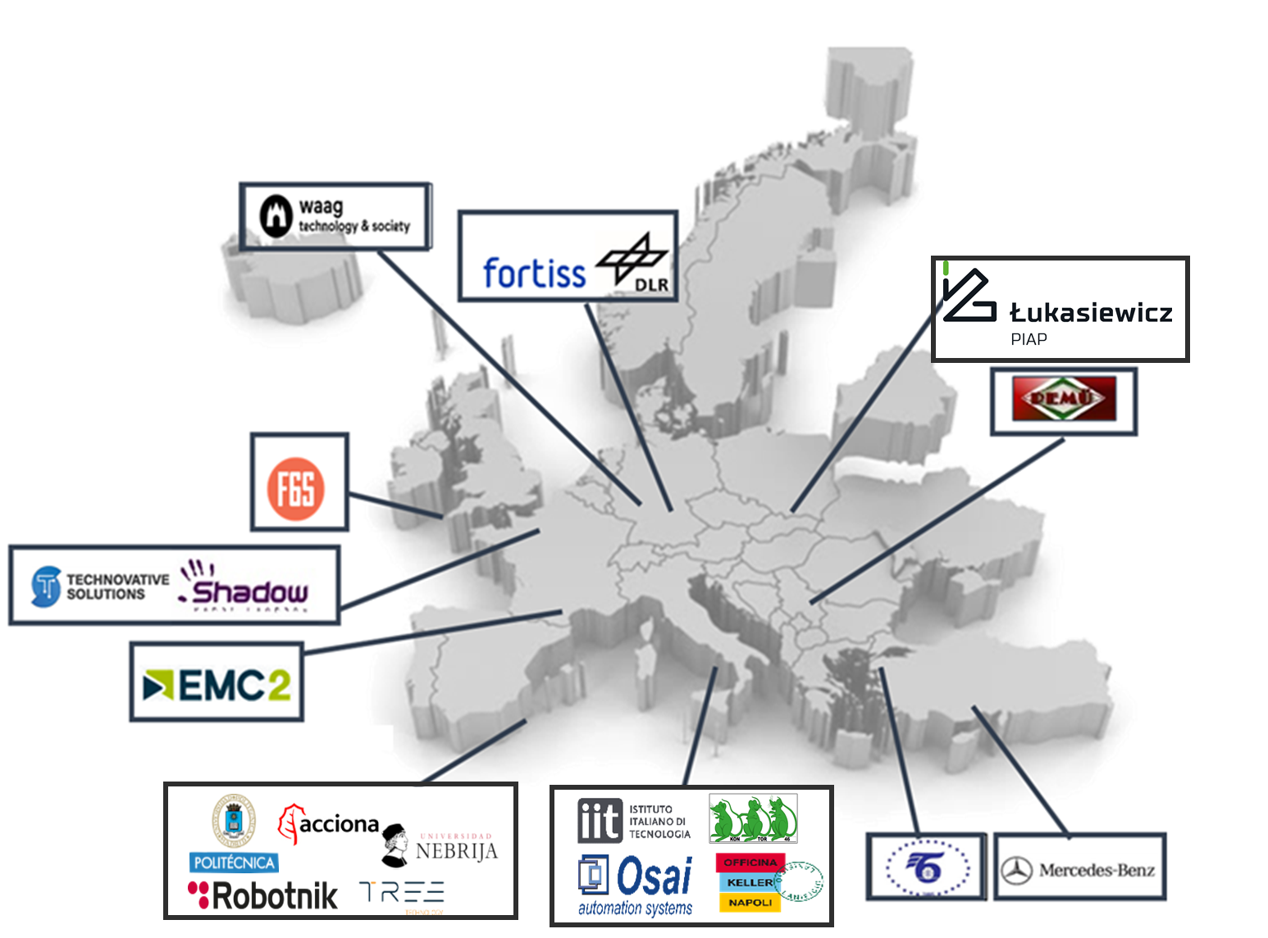
VOJEXT in a Nutshell
H2020 + DIHs + S+T+ARTS Innovation Action
Start date: July 1st, 2020
Duration: 42 months
20 EU partners / 11 EU countries
5 Pilots
Construction
Electronic
Automotive
Plastics & Polyurethanes
Artisans
This project has received funding from the European Union’s Horizon 2020 research under grant agreement No 952197
Notes:
The project aims to provide a favourable business and technological framework for cognitive autonomous systems supporting human-robot interaction. The project dynamizes science-driven industry approaches engaging human and Cyber Physical Systems (CPS) in the same loop; thus amplifying the cognitive capabilities needed to achieve more effective sociotechnical and business ecosystems.
For this purpose, VOJEXT will design, develop, and demonstrate affordable, market-oriented, multipurpose and easy-to-repurpose robotic systems; to be developed as one of the main components of a smart and scalable CPS ecosystem for the manufacturing and construction industry.
VOJEXT demonstrates its value through five (5) different experimental pilots; which will be evaluated in five (5) different sectors (plastic textile, electronics, automotive, construction and creative architecture for urban regeneration); covering the construction and manufacturing sectors at large in four (4) different locations (Spain, Hungary, Italy and Turkey). VOJEXT covers traditional and non-traditional areas for AI-robotics and cognitive ICT developments, extending its activities to new fifteen (15) demonstrators through open calls.

Slide 3
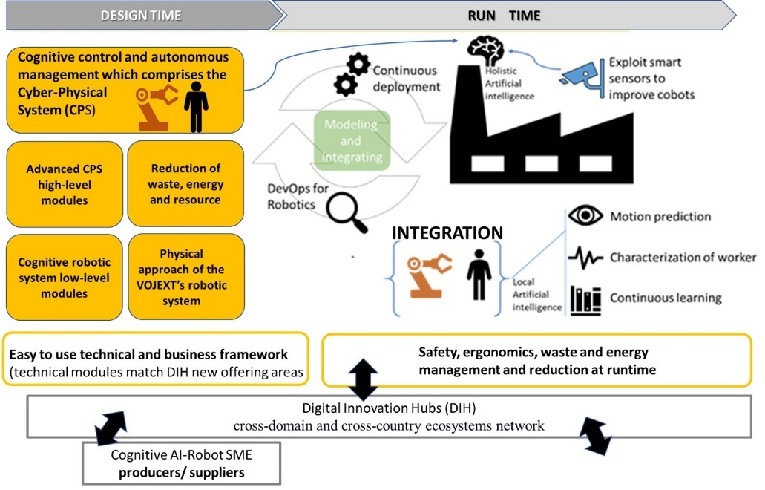
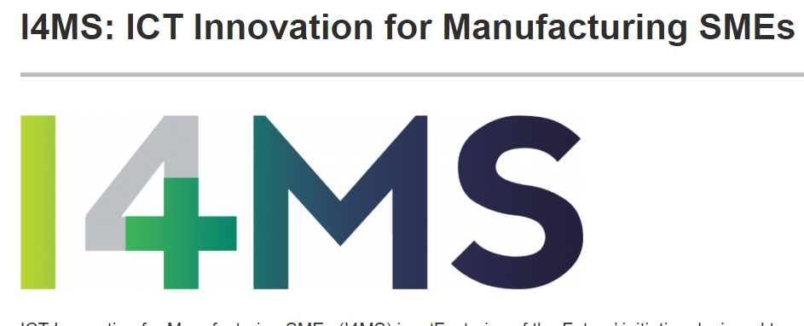
VOJEXT – Motivation (Why)
Innovation-based economic development using science-driven industry approaches → Experimental
Support producers and adopters (SMEs + small crafters) → Cognitive autonomous systems + human-robot interation
Guarantee SOCIAL, safety, security and ergonomics, → greatest challenges for human-robot collaboration → Social PM
Collaborative robotics through current and innovative offering of Digital Innovation Hubs (DIHs).

Slide 4
VOJEXT OPEN CALLS
2 Open Calls:
Call#1 (M9-March 2021 – ICT-Software/Technical SMEs
Extend the capacity and technology outreach of VOJEXT demonstrators by engaging tech SMEs in solving proposed technological challenges
Call#2 (M25 – August 2022 –Additional Pilots-€70K)
Deploy geographic and sector distributed small-scale pilots - expanding the scope of the existing use cases or deploying new ones at DIH living labs and/or SMEs/mid-caps facilities to demonstrate the impact/potential of VOJEXT technologies and approach towards digitising and boosting European industry
Notes:
uptake of digital game changers --- Expermentation -- Government – Test before invest / training → ecosystem – FLAGSHIP USE CASE

Slide 5
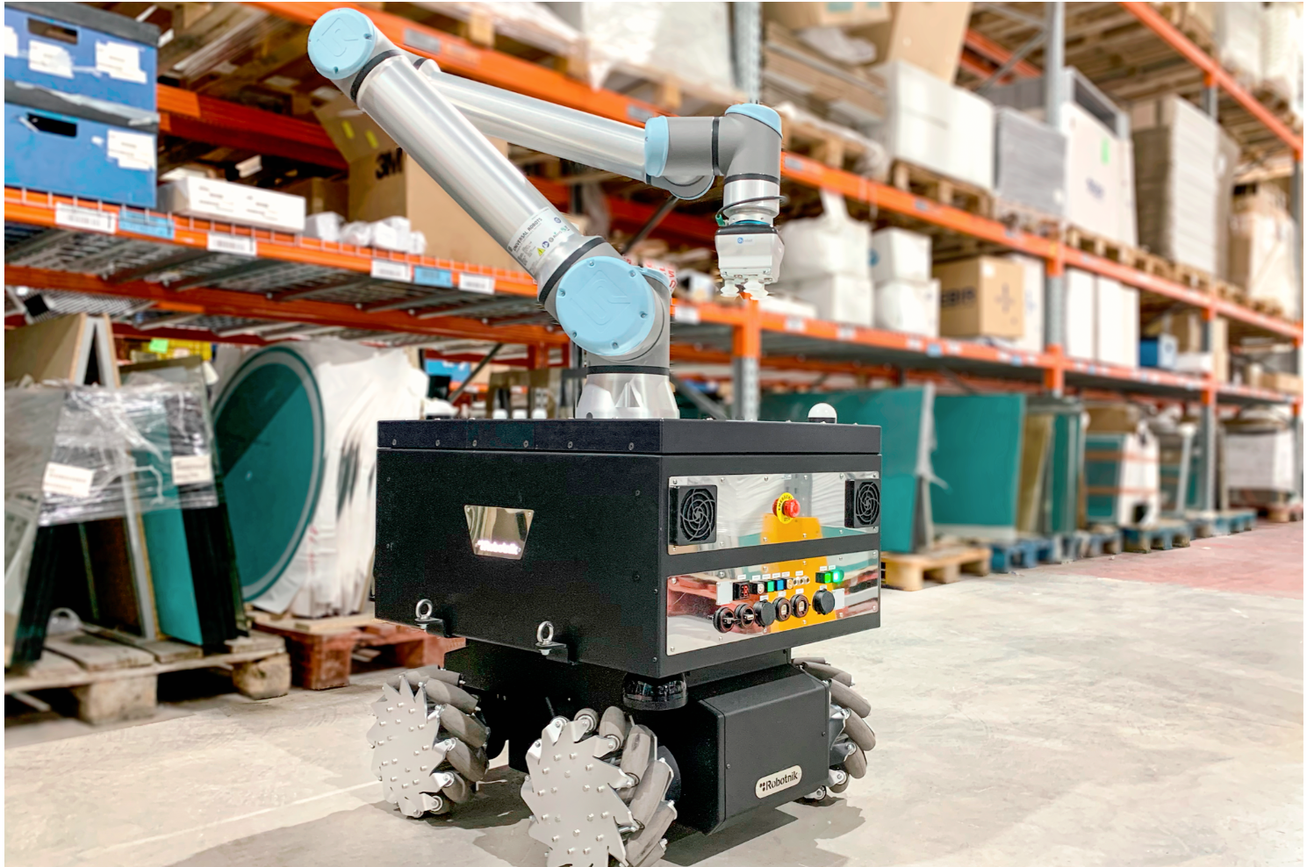
VOJEXT – 1ST OPEN CALL - CHALLENGE
VOJEXT will fund SMEs aiming to address specific challenges on cognitive autonomous systems for human-robot interaction.
Construction Robotic Toolset
A robotic solution designed for accomplishing plastering tasks with a robotic arm and 1 or more different end-effectors.
Navigation
Secure and autonomous robot navigation in highly dynamic environments.
3 Visualization of point cloud in a VR (Virtual Reality) headset
Allow user to navigate around the generated point cloud data using VR equipment.
4 Integrate two leap motion devices to improve user’s hand mapping Synchronize two leap motion devices to allow precise but cheap hand mapping.
Investigate new method of hand mapping and integrate it to the teleoperation pipeline:
Reproduce and Integrate a specific method (Megatrack) into the teleop pipeline. This method enable a real-time hand-tracking to drive virtual and augmented reality (VR/AR) experiences.
Notes:
uptake of digital game changers --- Expermentation -- Government – Test before invest / training → ecosystem – FLAGSHIP USE CASE

Slide 6
VOJEXT – 1ST OPEN CALL - COMING SOON
Why you should join VOJEXT ?
Funding
Up to €100K of funding per project
(equity free)
Who can apply?
The target applicants are SME’s and Mid-Caps.
When?
Launch: 1 March 2021 12:00 PM CET
Deadline: 30 April 2021 5 PM CET
9-12 months projects
Other Advantages:
You can transform your business with new products;
Expand your business network through the connection with artists and designers;
Get connected with others SMEs & Mid-Caps across Europe to share your journey
Don’t miss out this opportunity!
Notes:
uptake of digital game changers --- Expermentation -- Government – Test before invest / training → ecosystem – FLAGSHIP USE CASE

Slide 7
F6S
Luisa Gonçalves
Project Manager
(opencall@vojext.eu)
More info and instructions to apply @ https://vojext.eu/

